Slide 1
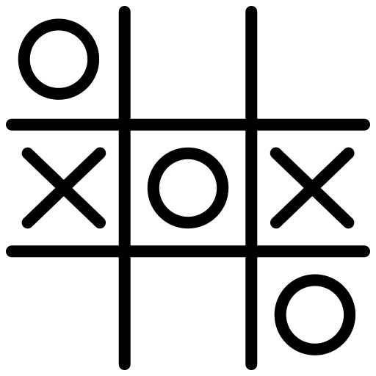
TIC TAC TOE GAME DEVELOPMENT USING MUTUAL EXCLUSION
OPERATING SYSTEMS | MINI PROJECT | REVIEW 1
by SATVIK SHARMA-RA2211029010003
PREM LOHIA-RA2211029010007
ANITEJ MISHRA-RA2211029010023

Slide 2
CONTENTS
Abstract
Introduction
Literature Survey
System and Design (using UML Diagrams)
System Requirements
Implementation
Results

Slide 3
ABSTRACT OF THE PROJECT
Mutual exclusion is a fundamental concept in computer science and concurrent programming, ensuring that only one process or thread can access a critical section of code at any given time.
In the context of game development, mutual exclusion plays a crucial role in maintaining game integrity and preventing conflicts between players. Here, we will see the application of mutual exclusion in the classic game of Tic- Tac-Toe and its implications for creating a fair and engaging gaming experience.
Tic-Tac-Toe is a two-player, turn-based game where each player strives to create a winning pattern of their symbols on a 3x3 grid. To implement mutual exclusion in this game, developers must address several key challenges.

Slide 4
INTRODUCTION
In the realm of game development, creating engaging and interactive experiences for players is a complex art. It involves a multitude of factors, including graphics, sound, user interface design, and most importantly, gameplay mechanics.
One fundamental aspect of gameplay mechanics is ensuring that players interact with the game world in a consistent and conflict-free manner. This is where the concept of mutual exclusion comes into play, and what better way to explore this concept than by examining it through the lens of the classic game of Tic-Tac-Toe?

Slide 5
INTRODUCTION continued…
Tic-Tac-Toe is a two-player game that dates back centuries. Despite its simplicity, it provides an excellent platform for understanding the importance of mutual exclusion in game development.
In this game, two players take turns placing their symbols on a 3x3 grid, aiming to form a row, column, or diagonal of their symbols while preventing their opponent from doing the same.
The key challenge here is to ensure that both players cannot occupy the same grid cell simultaneously, illustrating the concept of mutual exclusion.

Slide 6

LITERATURE SURVEY
Paper Title: “A Review of various Mutual Exclusion Algorithms in Distributed Environment”
Authors: NISHA YADAV, SUDHA YADAV, SONAM MANDIRATTA
Publication Year: 2015
We referred to this research paper to understand the concepts of mutual exclusion and implement it in our project for developing a fair, simple game of tic tac toe using C.
Scan this QR code to see the paper:

Slide 7
LITERATURE SURVEY continued…
Paper Title: “Implementation of Tic-Tac-Toe Game in LabVIEW"
Authors: LALITHA SAROJA THOTA , NASEEMA SHAIK , RAWAN ALI AND OTHERS .
Publication Year: 2014
We referred to this research paper to understand the various techniques of developing a Tic Tac Toe game in C.
By understanding various other techniques of implementing the same, we can improve the understanding of our approach using mutual exclusion for doing the same game development for Tic Tac Toe.
QR Code:

Slide 8

LITERATURE SURVEY continued…
Book Title: “Operating System Concepts"
Authors: ABRAHAM SILBERSCHATZ, PETER BAER GALVIN, GREG GAGNE
Edition: TENTH
Publisher: WILEY
We referred to this book to understand what is Mutual Exclusion, Critical Section and how to use these concepts to write a code for a game of Tic Tac Toe.
QR Code:

Slide 9
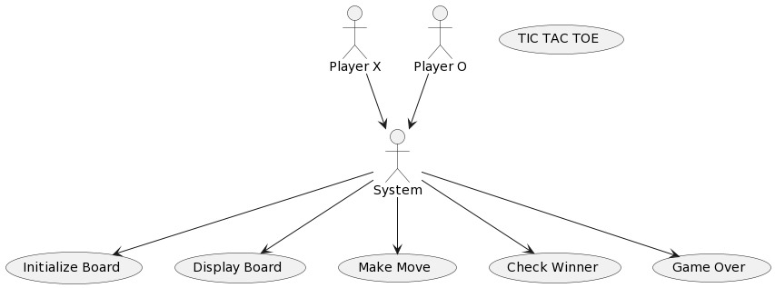
SYSTEM AND DESIGN Use Case Diagram

Slide 10
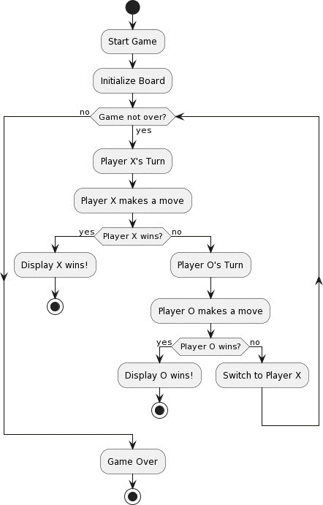
SYSTEM AND DESIGN Activity Diagram

Slide 11
SYSTEM AND DESIGN Algorithm used
initialize_board() function:
Initializes the game board by setting all elements to spaces (' ') to represent empty cells.
display_board() function:
Displays the current state of the game board, including the positions of 'X' and 'O' as well as empty cells.
make_move(int row, int col) function:
Checks if a move is valid by verifying that the specified row and column are within the board boundaries and the cell is empty.
If the move is valid, it updates the board with the current player's symbol ('X' or 'O') and increments the moves counter.
Returns true for a valid move and false for an invalid move.

Slide 12
SYSTEM AND DESIGN Algorithm used Continued…
check_winner() function:
Checks for a winning condition for the current player by examining rows, columns, and diagonals on the game board.
If the following winning condition is met, it returns true. Otherwise, it returns false.

Slide 13
SYSTEM AND DESIGN Algorithm used Continued…
player_thread(void* player_name) function:
This function represents the behavior of a player thread.
It runs in a loop as long as there are available moves on the board (moves < 9 for a 3x3 board).
It uses a mutex (mutex) to ensure that only one player can make a move at a time to prevent race conditions.
Displays the current state of the board and prompts the current player for their move (row and column).
Calls make_move() to make the move if it's valid. If the move results in a win or a draw, it exits the thread.
Switches the current player for the next iteration.

Slide 14
SYSTEM AND DESIGN Algorithm used Continued…
main() function:
Initializes the game board using initialize_board().
Creates two player threads (player_X_thread and player_O_thread) representing players 'X' and 'O'.
Each thread runs the player_thread function and passes the player's name ('X' or 'O') as an argument.
Waits for both player threads to finish using pthread_join().
The game concludes when one of the players wins or there's a draw.

Slide 15
SYSTEM REQUIREMENTS
OPERATING SYSTEM
Tic Tac Toe game development can be done on various operating systems, including Windows, macOS, and Linux. We can choose the one that we are most comfortable with.
DEVELOPMENT ENVIRONMENT
We can use a variety of programming languages and frameworks for developing Tic Tac Toe, such as Python, JavaScript (for web-based games), or even game development platforms like Unity or Godot. For our project we have chosen C in an Ubuntu terminal through a Virtual Machine.
HARDWARE
We don't need a high-end computer for this type of game development. A basic desktop or laptop with at least 4GB of RAM and a modern multi-core processor should suffice.
GRAPHICS
Tic Tac Toe is a simple 2D game, so we don't need a powerful graphics card. Integrated graphics on most modern computers will be more than enough.

Slide 16
SYSTEM REQUIREMENTS continued…
STORAGE
We don't need much storage space for code and assets. A few gigabytes should be sufficient.
MUTUAL EXCLUSION MECHANISM
To implement mutual exclusion for multiplayer or multi-threaded gameplay, we'll need a basic understanding of concurrency control mechanisms in our chosen programming language (in our case, C). This might involve using mutexes, semaphores, or other synchronization techniques.
TESTING
Testing the game will require a computer or devices to simulate multiple players. This can be done on a single machine with multiple instances of the game running simultaneously.

Slide 17
IMPLEMENTATION
Implementing mutual exclusion in a Tic Tac Toe game is important to ensure that only one player can make a move at a time, preventing conflicts and ensuring fair gameplay. In a game development context, mutual exclusion is typically achieved through locking mechanisms or synchronization techniques. Here's an overview of how we can implement mutual exclusion in a Tic Tac Toe game:
GAME STATE REPRESENTATION
Represent the Tic Tac Toe game state using a data structure, such as a 2D array, to track the positions of X’s and O’s on the board.
PLAYER TURN
Maintain a variable to keep track of whose turn it is, whether it's the X player or the O player.

Slide 18
IMPLEMENTATION continued…
MUTUAL EXCLUSION
Use a mutex (short for mutual exclusion) or a similar synchronization mechanism to ensure that only one thread or player can access and modify the game state at a time.
PLAYER INPUT HANDLING
When a player wants to make a move, they should first acquire the mutex or lock to gain exclusive access to the game state.
MOVE VALIDATION
Check if the move requested by the player is valid (e.g., the selected cell isempty). If the move is invalid, release the mutex and ask the player for another move.

Slide 19
IMPLEMENTATION continued…
UPDATING GAME STATE
If the move is valid, update the game state with the player's symbol (X or O) in the selected cell.
CHECK FOR A WIN OR DRAW
After each move, check if the game has been won by one of the players or if it has resulted in a draw.
RELEASE MUTEX
After updating the game state and determining the game's outcome, release the mutex to allow the other player to make their move.
For the code, you can scan this QR Code to see and download the file:

Slide 20
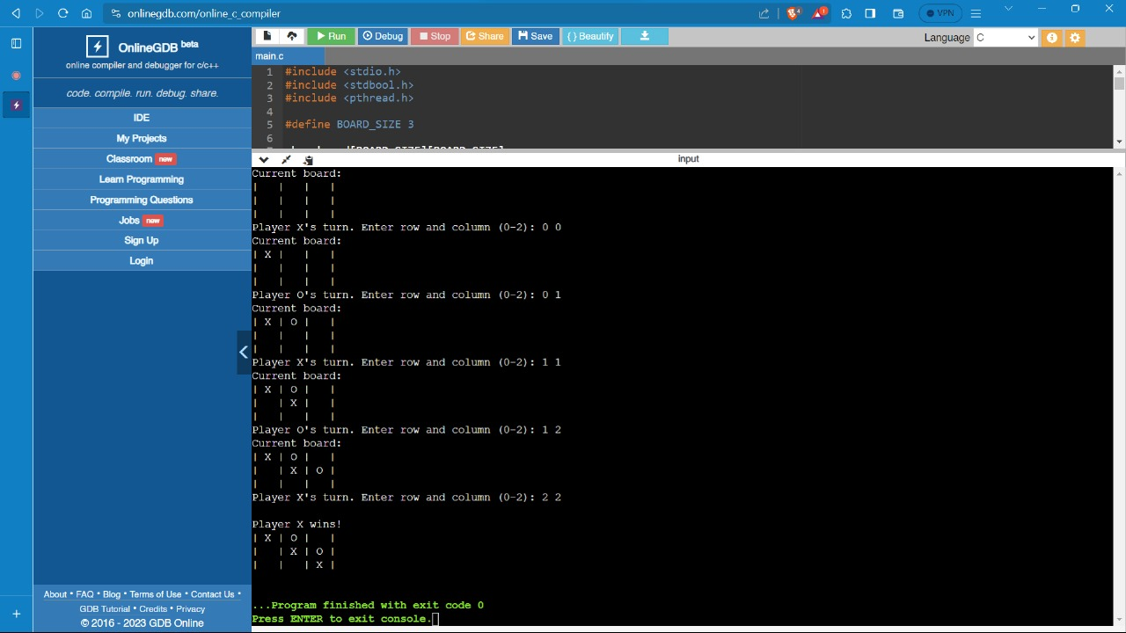
RESULTS Case 1

Slide 21
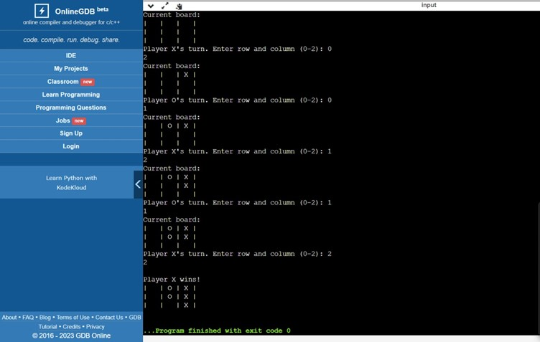
RESULTS Case 2

Slide 22
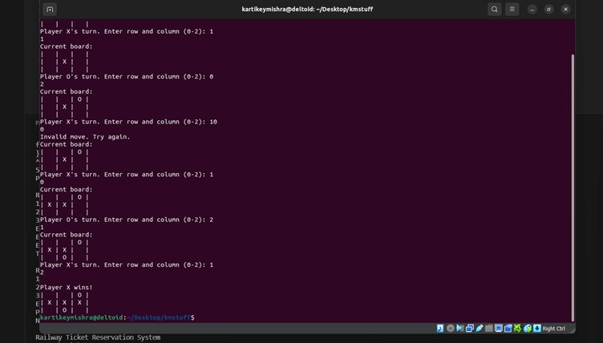
RESULTS Case 3

Slide 23
THANK YOU!
A project by
Satvik Sharma-RA2211029010003
Prem Lohia-RA2211029010007
Anitej Mishra-RA2211029010023

